Slide 1
Lightning Talk 8 – Ethics and Professional Responsibility
sdmay25-16
Client: Manojit Pramanik
Technical Advisor: Avishek Das

Slide 2
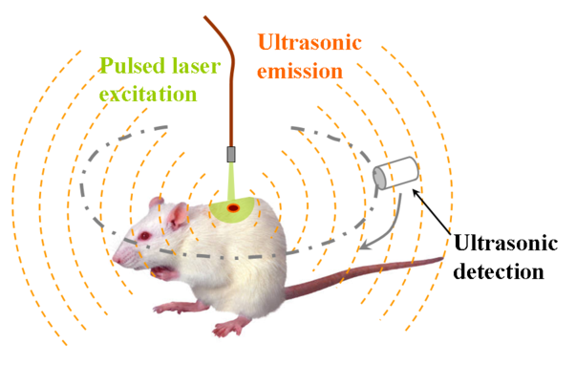
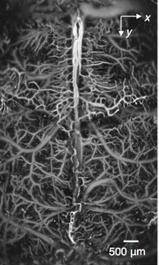
Project Overview
Problem Statement: Design and build an 8/16 channel amplifier with low noise to boost ultrasound signals received for a photoacoustic imaging system.
PC
(imaging software)
Amplifier

Slide 3
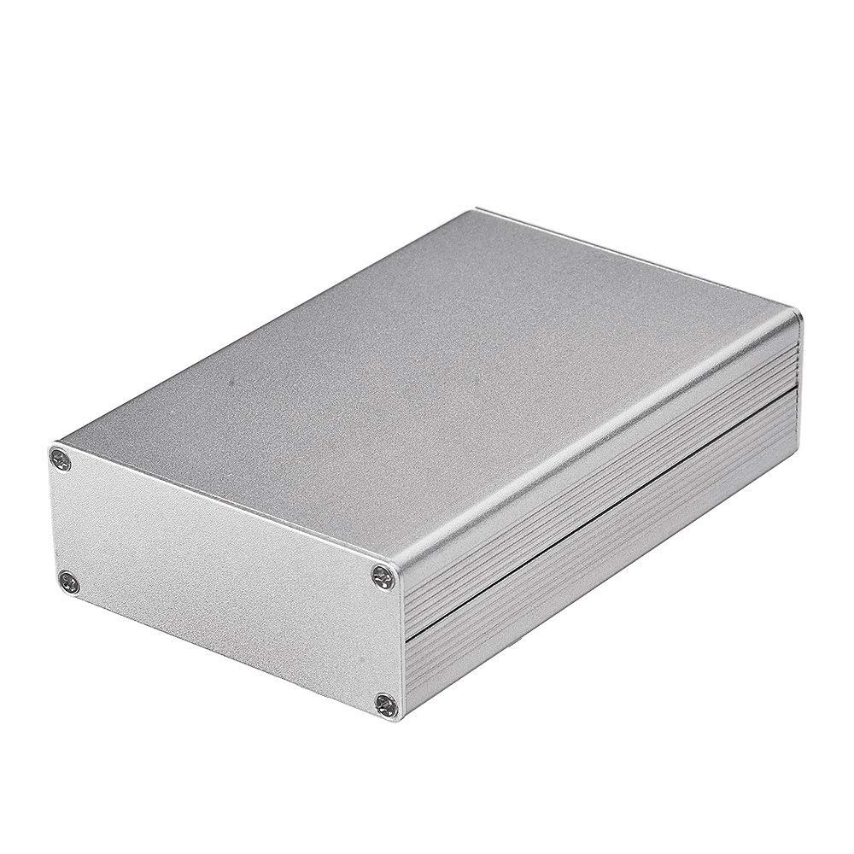
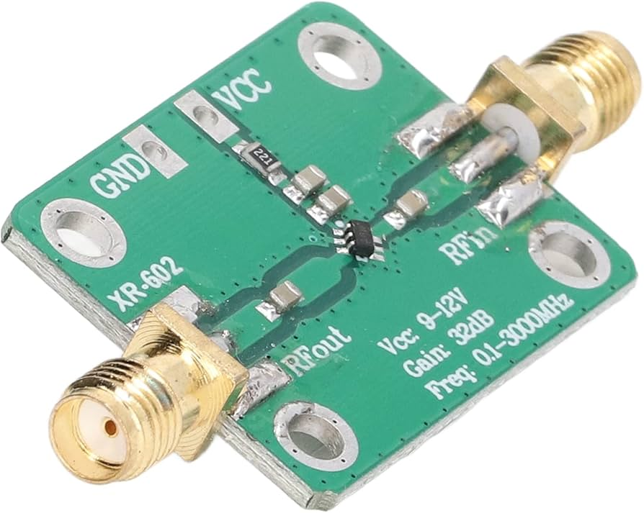
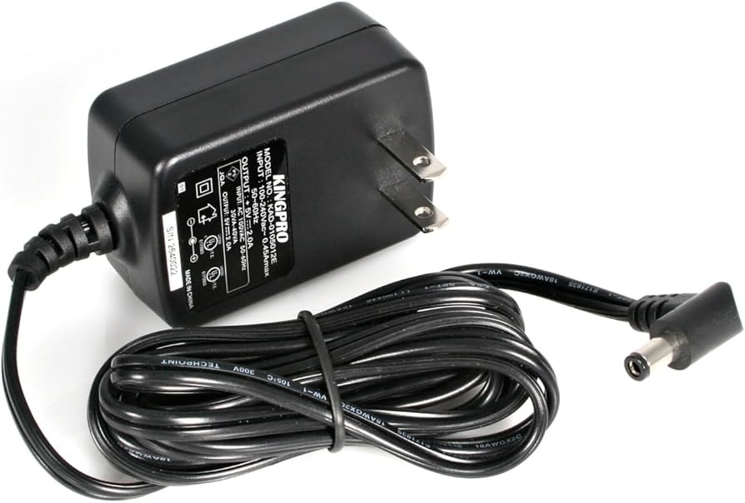
Project Overview
Enclosure
Amplifier Circuit (x16)
Design Specifications:
Low noise
Low input impedance
Bandpass filtering: 10kHz-10MHz
Small size (< 5x5 cm each)
ESD protection
Easily mountable
Power Supply

Slide 4
Ethical Ideals - Financial Responsibility
Our custom amplifier will be more expensive than an off the shelf part, so minimizing cost is important
Multiple ways to reduce cost while maintaining functionality:
Reducing waste in the prototyping stage
Design for cost: use components that are cheap and reliable
Simplify design to reduce unnecessary components
Our approach upholds ethical values because we are acting in the best interest of our client, and providing maximum value to their project

Slide 5
Ethical Ideals - Communication Honesty
Communication honesty is important in our project because we need to meet the specifications given for our project
Our approach to communication honesty:
Do not try to hide or minimize our failures
Admit when there is something we do not know (yet!)
Set realistic timelines
Our approach to communication honesty upholds ethical guidelines because it prioritizes truth in communication over our reputation. This will ensure the client is aware of any issues, even if it makes us look worse.

Slide 6
 | Beneficence | Nonmaleficence | Respect for Autonomy | Justice
Public health, safety, and welfare | Improve quality of medical imaging | Design assembled in house - does not support unfair labor | Designed according to client specifications | PAT imaging could provide more affordable medical care
Global, cultural, and social | Addresses the needs of medical professionals | Usable by all groups, no group is excluded intentionally | Does not assume cultural norms - intuitive design | Medical imaging will be used for people of all groups
Environmental | Imaging system is more compact, using less resources | Low power design minimizes greenhouse emissions | Could be designed to use lower power, trading off gain | Design will be used worldwide, minimizing unequal effects
Economic | Imaging system could create more jobs in the medical industry | Another alternative product in a large market will not hurt the economy | 8-channel versus 16-channel depending on budget | Low cost components and fabrication keeps product accessible

Slide 7
Other Potential Ethical Issues
What are the consequences of failure of our product?
What are the ethics of animal testing?
Does this imaging technology create privacy concerns?

Slide 8
Questions?

